Slide 1
Cordonel Service FW-Update
“Project Presentation”
Author: Thomas Wiedebusch
Version: 1.0
Date: 16.March 2021

Slide 2
Agenda
Introduction
System Overview
Presentation
FW-Update Builder
FW-Update Safe
FW-Update Loader
FW-Update Software
FW-Update Report
Project Status
Questions/Discussion
Notes:
Introduce to Cordonel Service
Please “Hold questions in the top of your head” until end of presentation

Slide 3
Introduction
Project Reason:
FW-Update ability for sold Cordonels for functional extension or BUG fixing
Project Aim:
- Update the FW in the Field to avoid HW exchange
Security Concerns:
License of SW’s – Version validation, User validation
Data Encryption – AES-CGM with AES256 Key
Secure FW- Update – 3 check stages – Builder, SW, FW
Protect Production Data Base – Usage of WEB-Interfaces

Slide 4
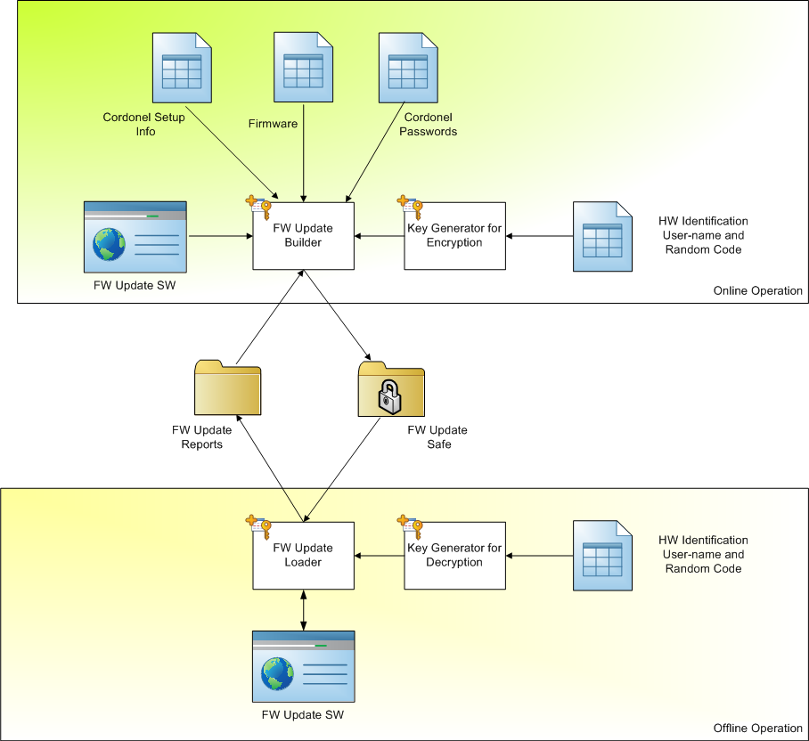
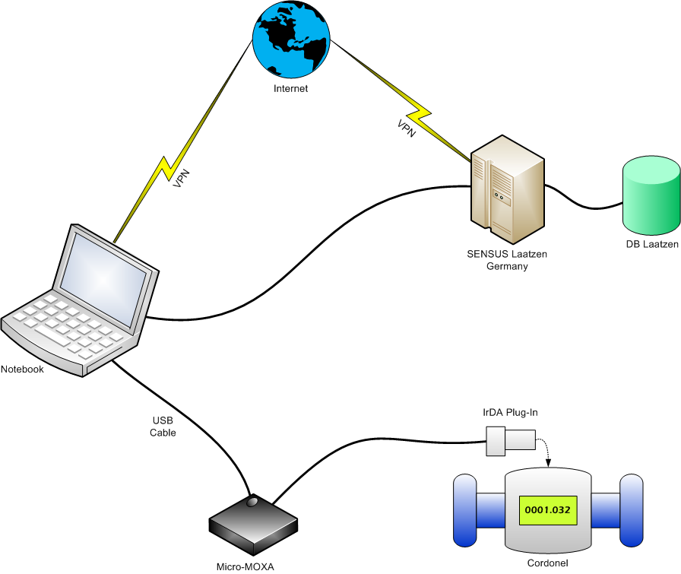
System Overview

Slide 5
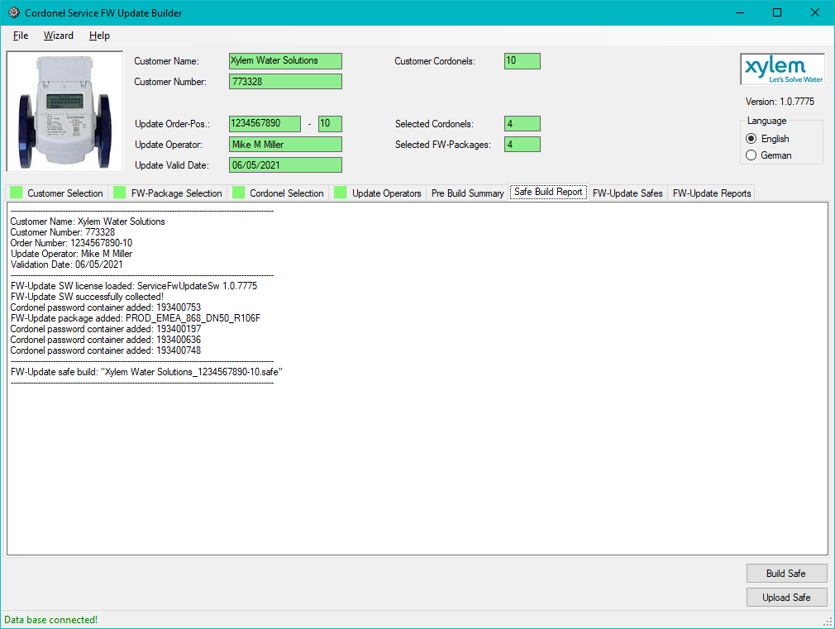
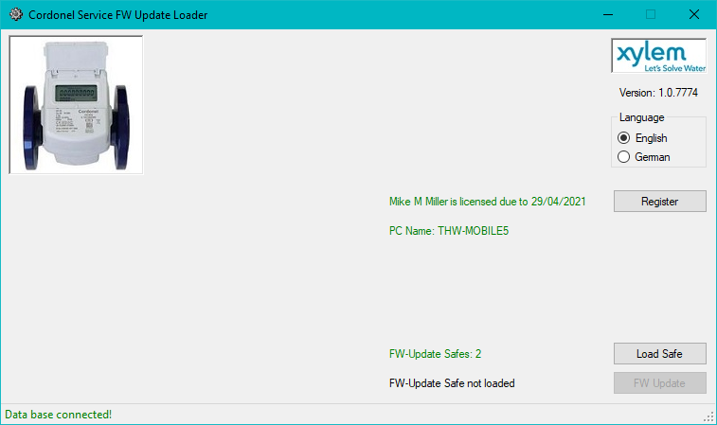
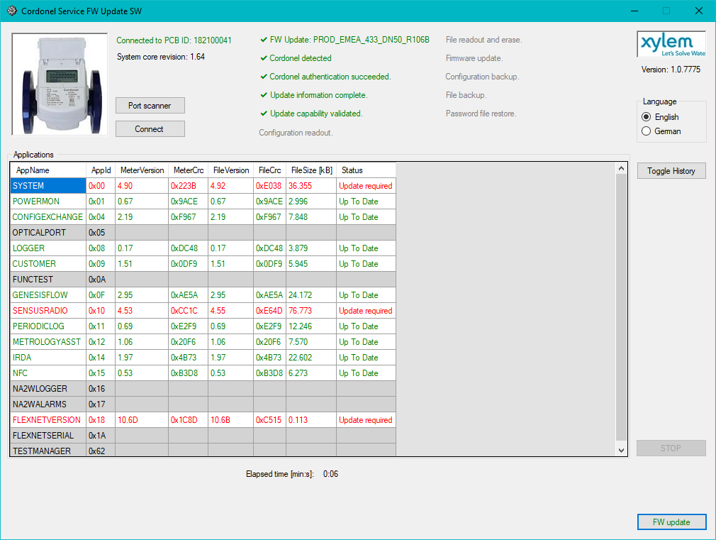
Presentation
Follow me on a short quick presentation
Notes:
Before we go into detail
To get a feeling for the system

Slide 6
FW-Update Builder
Functions:
Customer selection
FW-Package selection
Cordonel selection
Update Operator selection
Update capability check
Data collection
FW-Update Safe assembly
FW-Update Safe encryption
FW-Update Safe Upload

Slide 7
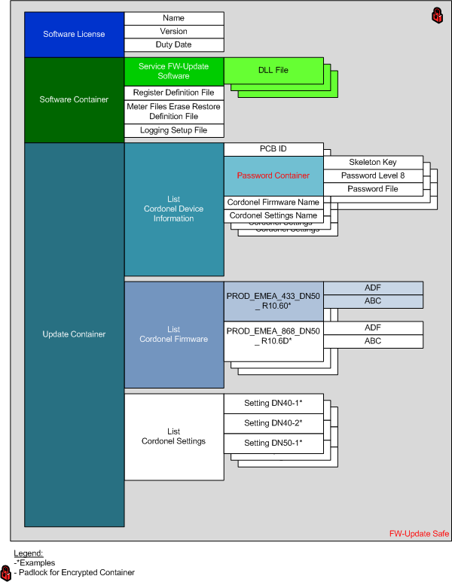
FW-Update Safe
Encrypted Data Container:
SW License
FW-Update SW
Passwords /-files
FW-Packages
Settings

Slide 8
FW-Update Loader
Functions:
Update Operator Registration
Loading of FW-Update Safes
Decryption of FW-Update Safes
Start of FW-Update SW
Reports Upload

Slide 9
FW-Update Software
Functions:
Update capability check
FW-Update Process
Report generation

Slide 10
FW-Update Reports
Two files will be generated:
The application file, listing all currently installed applications
The report file, which is a logger file in readable text format, it contains all information of the update process:
  Applications before and after the update,
  All registers (Settings) before and after the update,
  Meter files before, during and after the update,
  Update capability check,
  Process Step Information,
  Uncertainties during the update.

Slide 11
Project Status
FW-Update Builder:
Ready to used with additional information the FW-Update package,
Missing Final Update Capability Check due to lack of information
FW-Update Loader:
- Ready to use,
- Missing FW-Update Safe download/ erase automatic
FW-Update SW
- Full functional

Slide 12
Questions?
Open Discussion!

Slide 13
Thank you!

