Slide 1
TBF Common
Introduction
Topic: High-visibility clothing

Slide 2
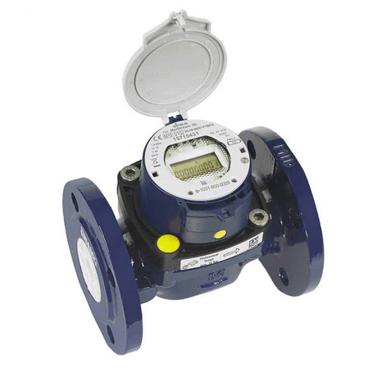
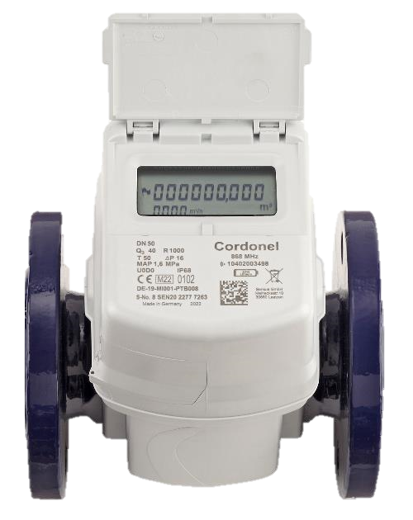
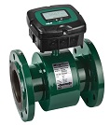
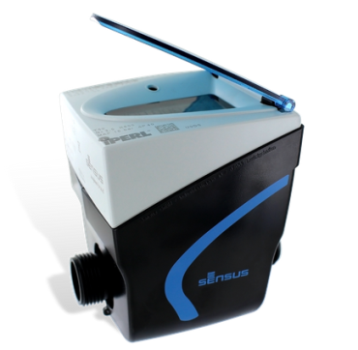
Agenda
Introduction to TBF:
GIT Repository
Project Structure
Example Class Diagram
OSI/ISO Layer

Slide 3
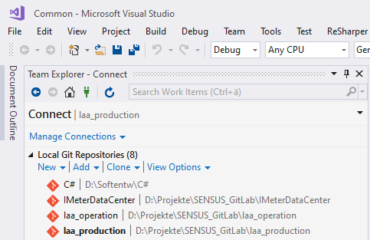
GIT Repository
GIT Repository:
https://slm.sms-esaap.com/la_operations/laa_production

Slide 4
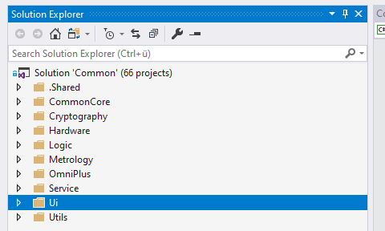
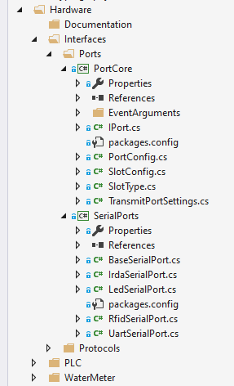
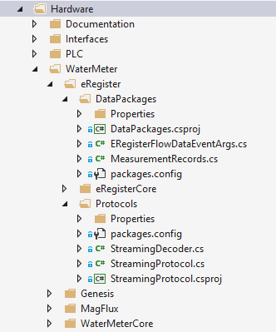
Project Structure

Slide 5
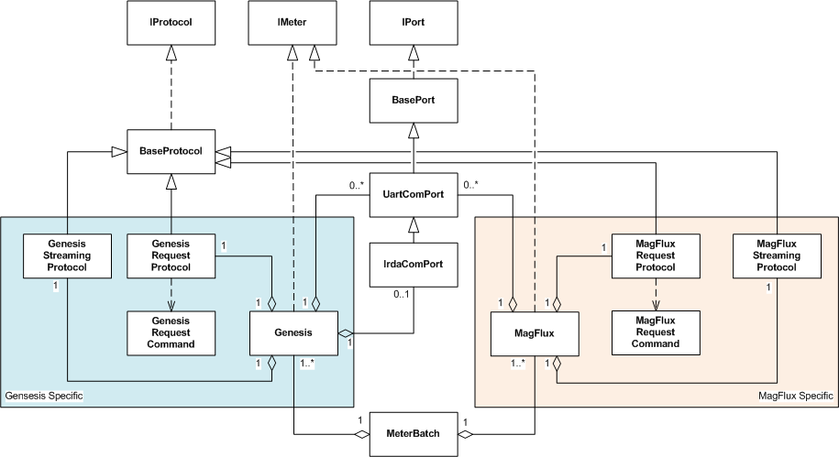
Example Class Diagram
IMeter:
Interface for meters
IProtocol:
Interface for protocols
IPort:
Interface for ports

Slide 6
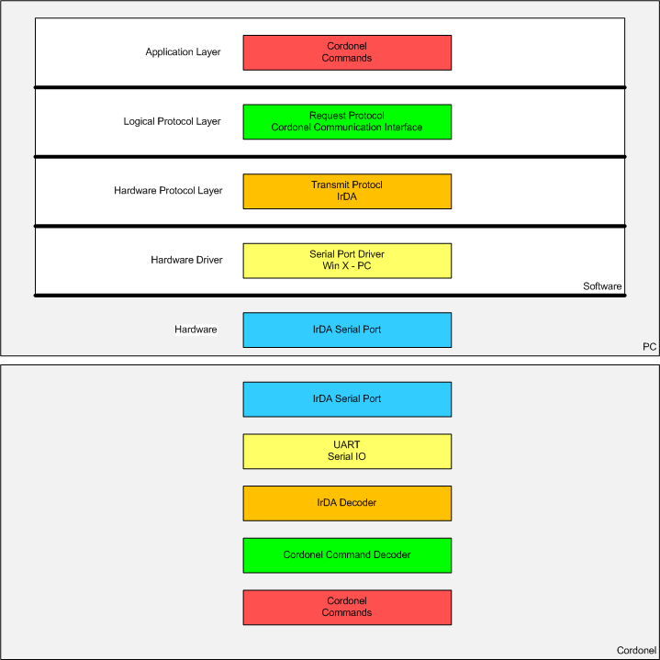
OSI/ISO Layer
Abstraction of Layers

Slide 7
Q&A

