Slide 1
Cordonel Parametrization
Risks and Uncertainties
Topic: High-visibility clothing

Slide 2
Agenda
Welcome
Reason of meeting
History
Description of problem
Search for solutions
Responsibilities

Slide 3
Reason for Meeting
Identified risks for reliable parametrization of Cordonel
Information to managers of this uncertainty
Description of the actual work flow
Request for support by mangers for organisation

Slide 4
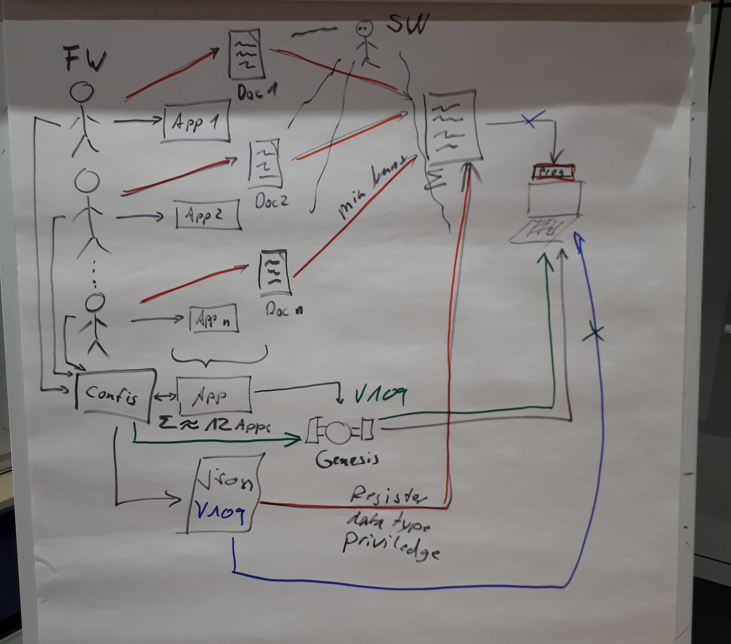
History
Request for an INTERFACE between Software and Firmware (configuration.json)
  Date 04/06/2018
  Minimal Requirements:
    Versioning
    Min/Default/Max Values
    Data Type
    Description of Usage

Slide 5
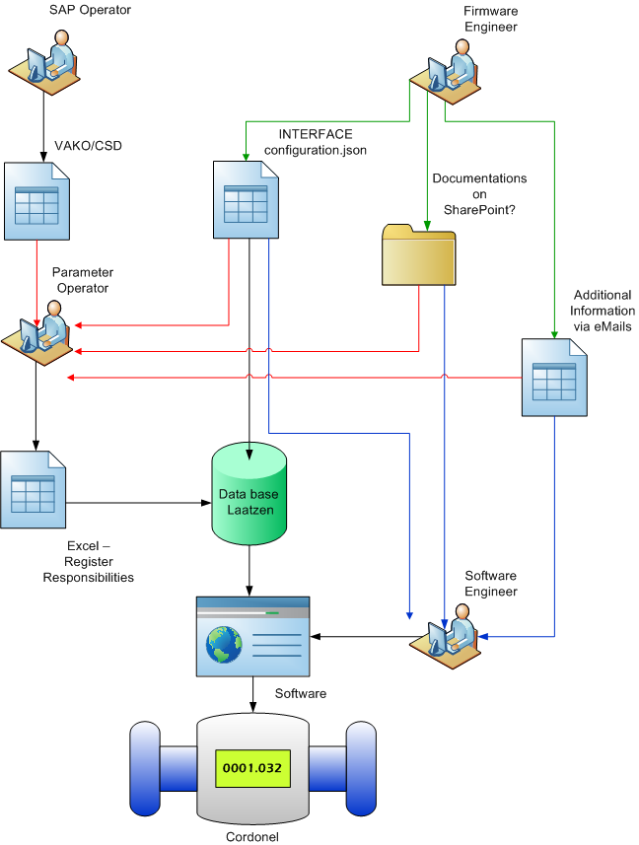
Description of Problem – Actual Workflow
Complex Workflow:
SAP Operator creates customer required settings
Firmware engineer creates INTERFACE, additional documents and answers questions via eMail
Parameter Operator has to inspect and combine all information
Software engineer has to inspect and combine all information and reprogram

Slide 6
Description of Problem
Lack of information:
Interface unclear defined
  Description field does not always inform about possible parameter range and resolution
Missing additional information
  Special sequences – working instruction recipe book – each App
  Latest documentation of processes
Workflow suspicious due to manual interaction
Software needs to know every single register (setting) to handle it adequate
Software has to be changed for every new Firmware release

Slide 7
Description of Problem - Examples
Examples in INTERFACE:
METROLOGYASST_PulseWeight description:
  Volume represented by one pulse in ml. If this is zero pulse output will not be enabled (until version 101)
  Volume represented by one pulse. Units of (2^-5)ml. If this is zero pulse output will not be enabled (from version 102)
METROLOGYASST_PulseMode description:
  The way pulses are output on the two available channels. This is an enum of type pulse_mode_t – what is pulse_mode_t ?
POWERMON_ TotalUsedCharge description:
  Accumulated charge used in uAs – Software cannot get the scaling in machine readable format
GENESISFLOW_ FirstHitLvlUp1 description:
  The first hit level in the upstream direction for channel 1, units of 0.88mV – Software cannot get the scaling in machine readable format

Slide 8
Search for Solutions
Interface requirements:
Unambiguous definition of usage of registers
Additional SI-Units as base for Input
Scale to convert from SI-Units to register-raw-values
Needed to be 100% machine readable
Advantage:
New parameters without functional change could be directly passed through by the Software without any code change

Slide 9
Responsibilities
tbd

